Slide 1
SFP Anlagestiftung
1. Anlegerversammlung
Zürich, 9. Mai 2019

Slide 2
Abstimmungen und Wahlen
Traktandenliste
Genehmigung des Jahresberichts und der Jahresrechnung 2017 / 2018 per 31.12.2018
Kenntnisnahme des Berichts der Revisionsstelle
Entlastung der Mitglieder des Stiftungsrates
Wahl der Mitglieder des Stiftungsrates für ein Amtsjahr
Wahl der Revisionsstelle (PwC AG)
Beschlussfassung über Antrag an die Aufsichtsbehörde zur Statutenänderung

Slide 3
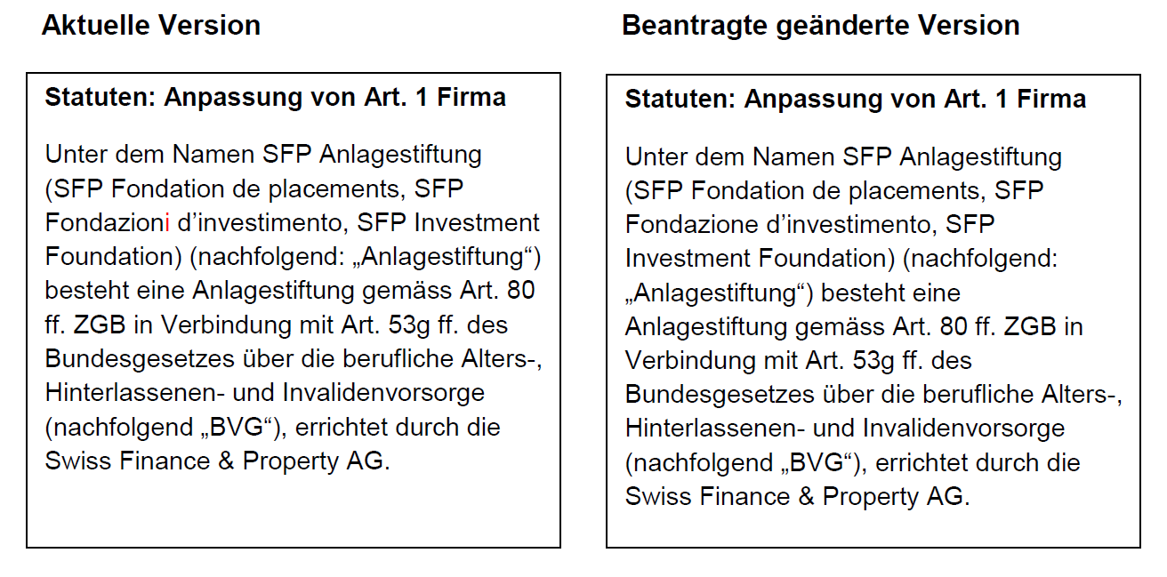
Beschlussfassung über Antrag an die Aufsichtsbehörde zur Statutenänderung
Traktandum 6 – Statutenänderung Art. 1 Firma, Art. 11 Abs. 7 lit. I) Anlagekommission und Art. 18 Neu: Inkraftsetzung (Änderung rot markiert)

Slide 4
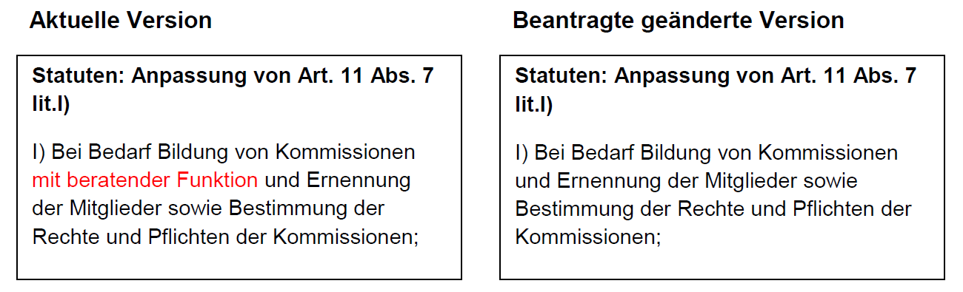
Abstimmungen und Wahlen
Traktandum 6

Slide 5
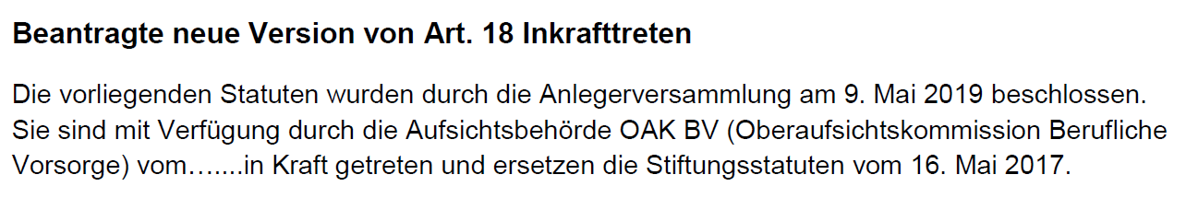
Abstimmungen und Wahlen
Traktandum 6

Slide 6
Disclaimer
The information in this document is confidential and may not be disclosed in or outside Switzerland to any other person without prior approval of SFP Investment Foundation. This document does not constitute an issue and/or an issue prospectus pursuant to Art. 652a and Art. 1156 of the Swiss Code of Obligations as well as Art. 27 et seqq. of the Swiss Listing Rules of SIX Swiss Exchange, a prospectus, simplified prospectus or a Key Investor Information Document (KIID) according to the Swiss Federal Act on Collective Investment Schemes or a financial research according to the Directives on the Independence of Financial Research of the Swiss Banking Association. The solely binding documents for an investment decision are available from Swiss Finance & Property Funds AG and/or SFP Investment Foundation. This document is a product of SFP Investment Foundation. The information and data contained in this document have been obtained from sources believed to be reliable. Neither SFP Investment Foundation nor Swiss Finance & Property Funds AG guarantee, represent or warrant, expressly or impliedly, that the information and data in this document are accurate, complete or up to date. All expressions of opinion are subject to change without notice by SFP Investment Foundation. Swiss Finance & Property Funds AG and/or SFP Investment Foundation accept no liability, including any liability for incidental or consequential damages, arising out of information and data contained in this document and/or the use of this document. Any proposed terms in this document are indicative only and remain subject to a separate contract. Nothing in this document shall constitute or form part of any legal agreement, or any offer to sell or the solicitation of any offer to buy any securities or other financial instruments or to engage in any transaction. Investments in securities or other financial instruments should only be undertaken following a thorough study of the relevant prospectuses, regulations, the basic legal information that these regulations contain and other relevant documents. Investments in securities or other financial instruments can involve significant risks and the value of securities or other financial instruments may rise or fall. No assurance can be given that the investment objective of any investment will be achieved or that substantial losses will not be suffered. Past performance does not guarantee or indicate current or future performance or earnings. The performance shown does not take account of any commissions and costs charged when subscribing and redeeming shares or interests in securities or other financial instruments. Swiss Finance & Property Funds AG and/or SFP Investment Foundation do not provide legal, accounting or tax advice. Investors in securities or other financial instruments are advised to engage legal, tax and accounting professionals prior to entering into any investments, transactions or other actions mentioned in this document. SFP Investment Foundation may from time to time have positions in, and buy or sell, securities and for other financial instruments identical or related to those mentioned in this document and may possess or have access to non-public information relating to matters referred to in this document which SFP Investment Foundation does not intend to disclose. No person shall be treated as a client of Swiss Finance & Property Funds AG and/or its affiliates and/or SFP Investment Foundation, or be entitled to the protections afforded to clients of Swiss Finance & Property Funds AG and/or its affiliates and/or SFP Investment Foundation, solely by virtue of having received this document. Neither this document nor any copy thereof may be sent to or taken into the United States or distributed in the United States or to any US persons or to any other state or territory where such distribution is contradictory to local law or regulation. Any eventual legal relationship resulting from the use of this document is governed by Swiss law. The place of jurisdiction is Zurich, Switzerland. The recipient of this publication and the investor in any financial instrument mentioned herein, respectively, undertakes to keep this publication and its content strictly confidential and not to further distribute it or make it publicly available and to comply with applicable Swiss laws, regulations and rules including but not limited to the Swiss Financial Market Supervisory FINMA and/or OAK BV guidelines.
© Copyright 2003 – 2019, Swiss Finance & Property Group AG and/or its affiliates and/or SFP Investment Foundation. All rights reserved.

Slide 7
Adresse
SFP Anlagestiftung
  Seefeldstrasse 275
  CH-8008 Zürich
  T +41 43 344 61 31
  F +41 43 344 61 30
  www.sfp-ast.ch

